Slide 1
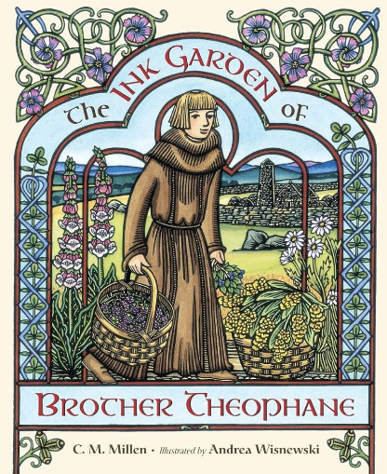
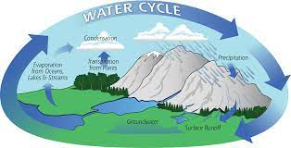
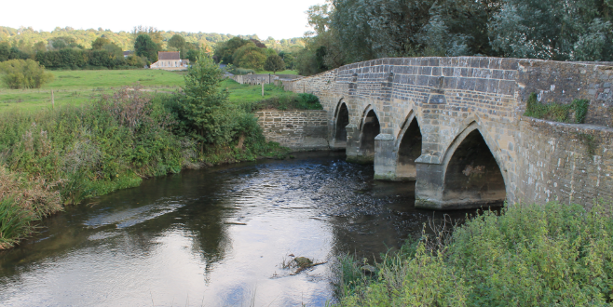
Literacy National curriculum
Text – Variety of humorous poems, writing to entertain - poetry.
Text – The Ink Garden of Brother Theophane, writing to inform – instructions & explanations.
R.E - Christianity
Does joining the Khalsa make a person a better Sikh?
Topic – UK Study
We will recognise the importance of rivers in settlements, travel and farming.
We will look at the features of a river, the journey to the sea. Great rivers of the world. The water cycle.
Music – Timbre , Body percussion, exploring different sounds, compose and perform a body percussion.
Computing – Programming
Sequencing in music.
Beech Class Summer 1 2024
Why are rivers so important?
PSHE – Being my best.
Keeping myself healthy.
Celebrating and developing my skills..
Numeracy National Curriculum
Yr2 –Fractions, time, problem solving and efficient methods, position and direction, statistics.
Yr3 – Fractions, Money, time, angles and properties of shapes, statistics.
P.E
Real P.E – Counter balance (with a partner)
Bath rugby
Art – Painting / Batik
We will explore different painting techniques, including watercolour and batik.
Outdoor sketching and photography to inspire final pieces.
Science – Animals including Humans
We will look at what living things need to stay alive and identify their offspring through life cycles. We will explore and find out about food groups and healthy balanced diets.

