Slide 1
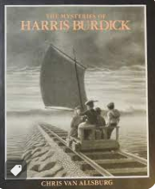
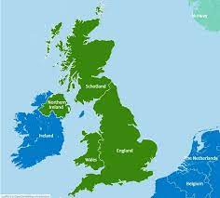
R.E - Christianity
Why do Christians put a cross in an Easter garden?
Topic – UK Study
We will recognise how London has changed over time as well as the UK as a whole .
Name countries and cities of the UK, name and locate main rivers and seas, name and locate some counties, name and locate areas of high ground and recognise how they are represented on a map.
Literacy National curriculum
Text – The Mysteries of Harris Burdick, writing to inform - diary.
Text – Flotsam, letters and non-chronological reports.
Music – Timbre , Body percussion, exploring different sounds, compose and perform a body percussion.
Beech Class Spring 2 2024
How great is Great Britain?
Numeracy National Curriculum
Yr2 –money, multiplication and division, length and height, mass, capacity and temperature
Yr3 – multiplication and division (2 digit by 1 digit), fractions, mass, capacity
Computing – Data and Information
Develop an understanding of branching databases.
PSHE – Rights and Responsibilities
Skills we needs to develop as we grow up.
Keeping safe.
Dealing with money.
Helping and being helped.
Looking after the environment.
Art – Printing
We will explore different printing techniques, including collagraph, mono, foam board and using everyday objects..
Science – Use of Everyday Objects
We will explore and carry out experiments to discover useful properties of materials including absorbency and flexibility.
Discover the inventors John McAdam and Kiara Nirghin.
P.E
Real P.E – Counter balance (with a partner)
Bath rugby

