Slide 1

Mastery in Maths

Slide 2
Aims:
To know what the Curriculum says about Maths
To look at what Mastery means and what underpins it
To know the CPA approach
To use some manipulatives
To do some maths!

Slide 3

Aims of the National Curriculum
Using and Applying/problem Solving in Context
Fluency and Conceptual Understanding
Reason Mathematically
Notes:
It is the preamble that provides us with the really important aspects of the new curriculum. If the programmes of study are looked at in isolation there is a danger of the teaching of mathematics becoming very process driven and lacking creativity.
The National Curriculum for mathematics aims to ensure all pupils:
become fluent in the fundamentals of mathematics, including through varied and frequent practice with increasingly complex problems over time, so that pupils have conceptual understanding and are able to recall and apply their knowledge rapidly and accurately to problems
reason mathematically by following a line of enquiry, conjecturing relationships and generalisations, and developing an argument, justification or proof using mathematical language
can solve problems by applying their mathematics to a variety of routine and non-routine problems with increasing sophistication, including breaking down problems into a series of simpler steps and persevering in seeking solutions.

Slide 4
What the curriculum says
The national curriculum for mathematics aims to ensure that all pupils:
become fluent in the fundamentals of mathematics, including through varied and frequent practice with increasingly complex problems over time, so that pupils develop conceptual understanding and the ability to recall and apply knowledge rapidly and accurately.
reason mathematically by following a line of enquiry, conjecturing relationships and generalisations, and developing an argument, justification or proof using mathematical language
can solve problems by applying their mathematics to a variety of routine and non- routine problems with increasing sophistication, including breaking down problems into a series of simpler steps and persevering in seeking solutions.

Slide 5
Teaching for Mastery
High expectations for every child
Fewer topics covered in greater depth
Number sense and place value come first
Problem solving is central
Challenge is provided through an increased depth, rather than acceleration of content

Slide 6

What does it mean to master?

Slide 7
Signature Bake - Fluency
I know how to do it (operations and their relationships)
It becomes automatic and I don’t need to think about it – to make a cake I need to add flour, eggs, sugar and butter (mental arithmetic)
I’m really good at doing it (speed)
I can show someone else how to do it (understanding)

Slide 8

Variation in Fluency
5 + 1 =
15 + 2 =
22 + 63 =
5 + ? = 6
? + 2 = 17
? = 22 + 63
20 ÷ ? = 5

Slide 9
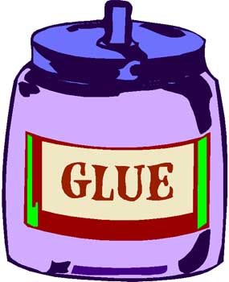

Technical Challenge - Reasoning
Deep and sustainable learning
The ability to build on something that has already been sufficiently mastered
The ability to reason about a concept and make connections
Conceptual understanding (comprehension of mathematical concepts, operations and relations) and procedural fluency (ability to formulate, represent and solve mathematical problems.
“Reasoning is the “glue” that helps mathematics make sense.”

Slide 10

How do we help children to communicate their reasoning?
  I think this because
  If this is true then
  I know that the next one is….. because
  This can’t work because
  When I tried….I noticed that
  The pattern looks like
  All the numbers begin with
I am going to count to 20.
I start at 8.
Will I say 11?
Convince me.
Spot the mistake:
19, 18, 16, 15, 14
What is wrong with this sequence of numbers?
I count backwards from 20
How many steps does it take me to get to 7?

Slide 11
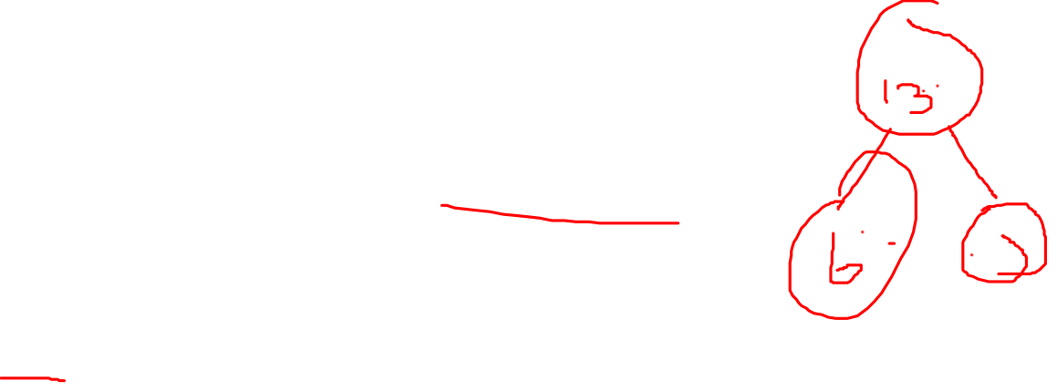
Show Stopper – Problem Solving
Sophie went to the shop and brought 5 bananas and 6 apples. How many pieces of fruit did she buy altogether?
Altogether Sophie and Ethan have 13 apples. Sophie has 6 apples. How many has Ethan got?
Sophie and Ethan have 20 apples. They both have an even amount each? How many could they have?
5 + 6 = ?
6 + ? = 13
? + ? = 20

Slide 12
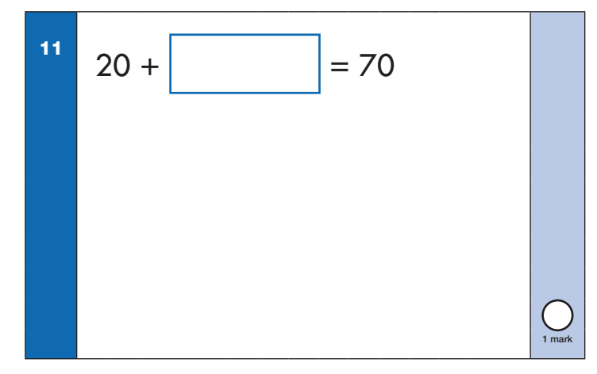

Slide 13
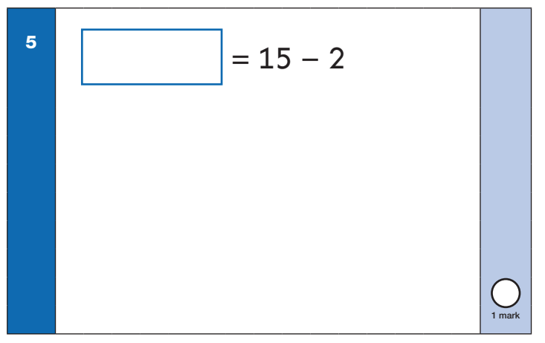

Slide 14
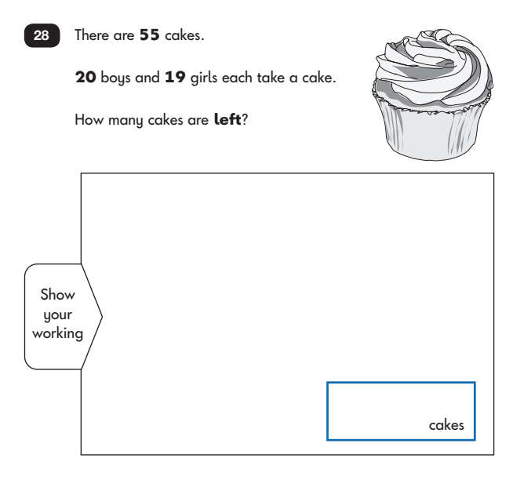

Slide 15
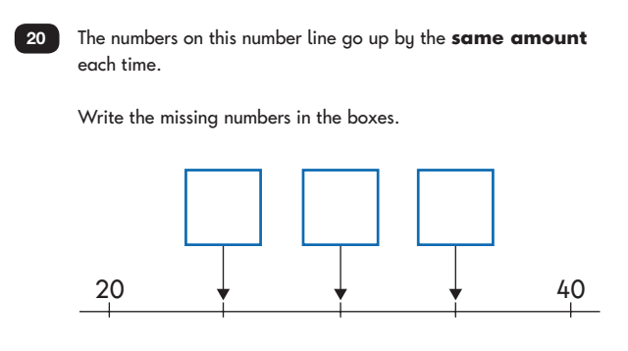


Slide 16
Teachers will secure fluency and then go deeper by using reasoning and problem solving
For example, if the learning intention was to multiply and divide whole numbers and those involving decimals by 10, 100 and 1000 (Year 5) a series of questions may be …

Slide 17
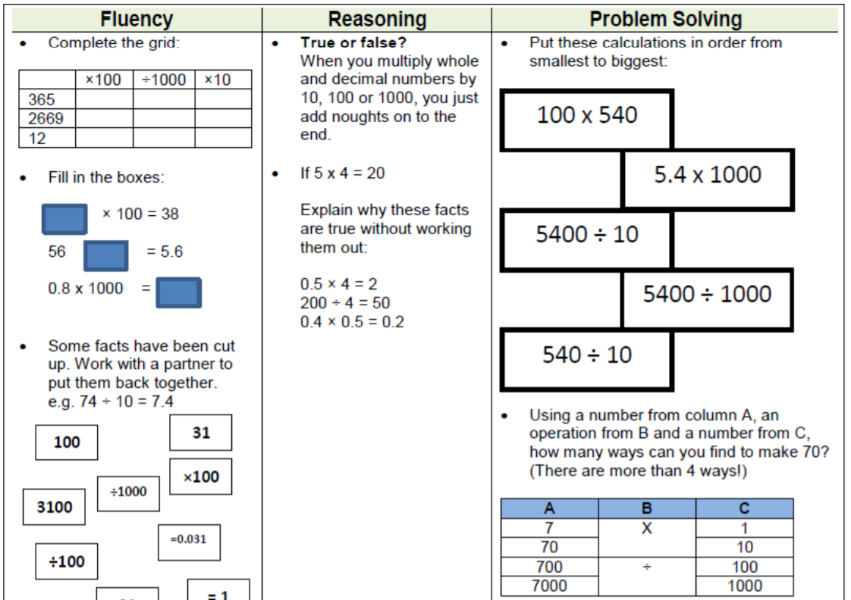

Slide 18

So…what strategies and manipulatives help children achieve mastery?

Slide 19
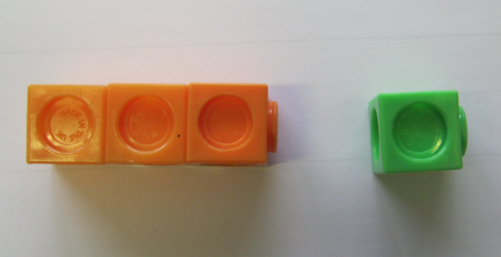
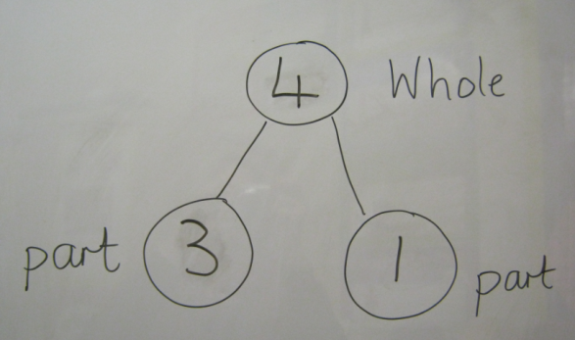

Concrete
Pictorial
Abstract
3 + 1 = 4
Concrete or pictorial representations support children to understand abstract concepts and deepen understanding.
Notes:
The concrete, pictorial, abstract approach is a progressive teaching strategy to ensure that children’s learning and understanding is deep. Therefore, they can apply this to different contexts and situations.
Concrete refers to the physical resources and objects which children may use to investigate with, identify patters with and reason with others, to reach possible answers / solutions.
Once children are secure with using concrete material to understand an idea they progress to representing the model through pictures and diagrams.
The final stage of children’s understanding is for them to represent the model using numbers and symbols. This is the abstract part of this approach.
In the example above, children are investigating addition of two digits.
They begin using multilink cubes, where the two digits are represented by different colours. They explore what the digit looks like using the resources and the meaning of addition.
They then progress to the pictorial representations. Here you can see two models. The first is a part part whole model and the second is the bar model (which we will come to later).
Finally, the children are able to use numbers to represent their investigation.
Through this deep understanding, children will be able to investigate the inverse and explore the subtraction.

Slide 20
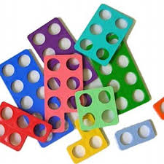
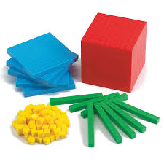
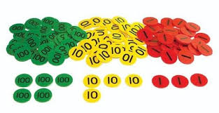
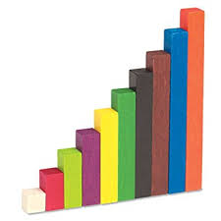
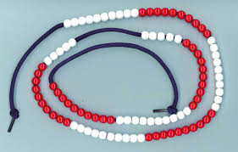
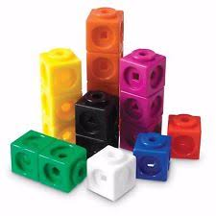

Manipulatives

Slide 21
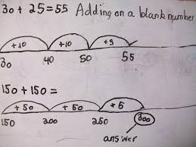
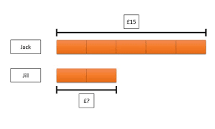
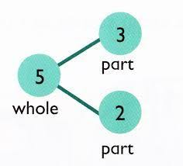
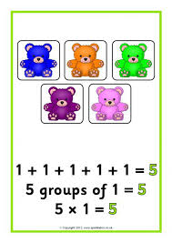
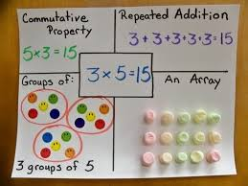
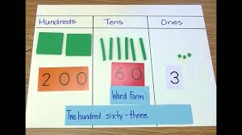

Pictorial Representations

Slide 22
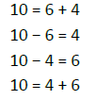
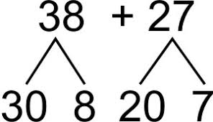
Abstract
5 + 12 = 17
Place the larger number in your head and count on the smaller number to find your answer.
Divide 28 into 7 groups. How many are in each group?

Slide 23
How can you support at home?
Maths learning can happen anywhere. Maths is all around us and problem solving is at the heart of the mastery approach. Look for maths problems you can solve together, making connections between what your child has been learning at school and the world around them.
• Follow a recipe: work together to find out the quantities needed, ask your child to weigh the ingredients, discuss how you’d halve or double the recipe and discuss the ratio of ingredients.
• Talk about the weather forecast: is today’s temperature higher or lower than yesterday’s? What do the numbers mean?
• Going shopping: talk about the cost of items and how the cost changes if you buy two items instead of one. Let your child count out the coins when paying and discuss the change you get back. Use coins to explore addition, subtraction, multiplication and division.
• Planning an outing: discuss how long it takes to get to the park, and so work out what time you need to leave the house. Encourage your child to work out the best solution based on the time and distances. Discuss what shapes you see when you get there.

Slide 24
Mathematics language often uses common words in a new way. For example, ‘difference’, ‘right’, ‘product’, ‘table’.
• Always encourage your child to explain how they have gone about solving a problem, and work with them to test, prove, explain, reflect and spot patterns. Questioning and prompts can be powerful tools to boost your child’s mathematical thinking: ‘What do you think…?’ ‘Why …?’ ‘What will happen if…?’ ‘What do you notice about…?’ ‘Can you see a pattern between…?’ ‘What if we try…?’
• Communicating and discussing maths problems (in a way that others can understand) demonstrates depth of understanding – another fundamental aspect of mastering mathematics.

